Slide 1

Polyglot Programming
How to do It right ?

Slide 2
Praseed Pai KT
Sr. Solutions Architect
Gadgeon Smart Systems Pvt Limited
Kochi, India

Slide 3
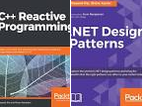

About the Presenter
A Seasoned Software Engineering Professional with more than twenty five years of Exposure
Author of Two books on Computer Programming
Explorer in “Philosophical Tools for Software Engineering” ( Has Presented on it, Written one university accredited
paper, Designed a Pattern based on Advaita Vedanta to transition from OOP to FRP)
An Expert level professional in Cross Cultural Encounters
A Critique of Digital Technology Fads ( Programmers will be better off , if they stick to Programming. Do not run
after so called AI/ML, BlockChain etc ) - “Plumbing is preferred over Painting!”
Has Presented in more than three hundred sessions in the past twenty five years
I also help Programmers eliminate their “Math-Phobia”
Currently designated as “Sr. Solutions Architect @ Gadgeon”

Slide 4
Gist of the Presentation
Polyglot - The term and it’s meaning
Poly-this,Poly-that --- How do u make sense of it?
Programming – Formal Models/Paradigms/Compilation/Expressive Power/Intent
specification ( How to view PL landscape?)
Encoding Architecture/Design/Models/Techniques in a Language Agnostic Manner.
How to Transfer Ontology/Idioms/Patterns/Style from One language to another?
Pragmatics of working as a Polyglot Professional
Anecdotes/Case Studies/Stories/Events which mandated Polyglot development.

Slide 5
Putting things into Context

Slide 6

Let us meet
Kato Lomb!

Slide 7
Q&A with Kato Lomb
Question: Is it possible to know 16 languages?
Answer: No, it is not possible—at least not at the same level of ability. I only have one mother tongue: Hungarian. Russian, English, French, and German live inside me simultaneously with Hungarian. I can switch between any of these languages with great ease, from one word to another.
Translating texts in Italian, Spanish, Japanese,Chinese, and Polish generally requires me to spend about half a day brushing up on my language skills and perusing the material to be translated.
The other six languages [Bulgarian, Danish, Latin, Romanian, Czech, Ukrainian] I know only through translating literature and technical material.
Question: Why haven’t you chosen a career in foreign language teaching?
Answer: In order to teach, it is not enough to have mastered a whole army of languages. To look it at another way, surely there are many unfortunate people who have needed to undergo multiple stomach surgeries. Yet no one would hand a scalpel over to them and ask them to perform the same surgery they received on another person, simply because they themselves had undergone it so often.If those individualswho conduct surveys and polls had a sense of humor when asking us our occupations, my answer would be “language learner.”
Question: Does one need an aptitude to learn so many languages?
Answer: No, it is not necessary. A side from mastery in the fine arts, success in learning anything is the result of genuine interest and amount of energy dedicated to it. In my own experience learning languages, I have discovered many useful principles. This book outlines them for you.
I wish to acknowledge that my achievement in languages is due to my collaborators over the years, known and unknown. This book is dedicated to them.

Slide 8
Why we (Indians) are natural Polyglots?
Before I move into the techniques , I would like to write a word of encouragement for Indians. We have got "polyglot" gene ( ala "math gene" ),
embedded inside us because of the multilingual environment we are in.
An average Indian , will master at least three languages
A) Native Tongue (Malayalam,Tamil,Kannada,Oriya etc)
B) English ( Lingua franca of the world )
C) Hindi ( being the national language )
Only exceptions are people in Hindi Heartland , where they might learn only two (Hindi/English) In the case of Keralites, Tamil as an additional language by virtue of Tamil Film Industry. A person like me will have one more tongue as I speak Konkani at home. Additionally,I have studied Japanese ( Hiragana, Katakana and 150 words of Kanji ) Can an Indian afford to say that he will speak only one language ? So,becoming polyglot in natural languages is natural for us.
Why cannot we extrapolate this instinct into Programming languages ?

Slide 9
A Word of Caution!
“Most people consider spending time on learning additional programming language is a waste of time . In the name of focus, some headhunters do reject people with skills in multiple languages and technologies. Those are "political" problems which this series do not consider. The topics are dealt at a cognitive level over here”
- Praseed Pai (from the blog, ”Analysis leads to Paralysis”)

Slide 10
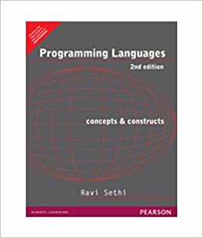
A Remarkable Book By Ravi Sethi

Slide 12
Whet your appetite!

Slide 13
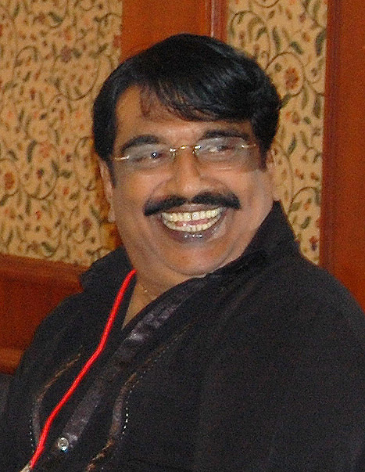
Comparative Study of Programming Languages
In India , it is like this. I do not how it is in Punjab? – Punjabi House

Slide 14
Programming Languages – A Model driven reality
By Formal Models – Turing Machine/Lambda Calculus/Predicate Logic based Languages
By Typing – Static/Dynamic and Type annotation based languages
By Expressive Power – Turing Complete and Otherwise languages
By Compilation Strategy – Compiled/Semi-Compiled and Quasi Compiled ( Interpreted languages)
By Programming Paradigms – Procedure/Functional/Logic/Object Procedural/Object Functional
By Intent specification – Declarative vs Procedural

Slide 15
A Tactical Approach towards Learning Multiple Languages
Hello Script in Python/Java/Ruby
Maintain a Text File of Executable Code snippets
Pros
A Bootstrapping Strategy
A Handy Tool for “Assembling” Code very fast
Please your boss!
Cons
Too much Axiology driven
Cannot exploit deeper synergies between languages

Slide 16
Let us Jump into the water!
A Straight Line Program which accepts a list of numbers as command line arguments and sort them, to print to the Console
Implementation in Java/C#/Python/JS
Improving the above program by Data Parametrization
Implementation in Java/C#/Python/JS
Improving the above program by adding Type Parametrization
Implementation in Java/C#/Python/JS
Improving the above program by adding Behaviour Parametrization
Implementation in Java/C#/Python/JS

Slide 17
Three Kinds of Polyglots
So called “Full Stack” developers (Seemingly Polyglot )
Modern Software Developers (Polyglot by Imperative )
True Polyglots ( Polyglots by choice )

Slide 18
An Unusual story of JavaScript

Slide 19
A Story of JavaScript
A Programmer was asked by his “boss” (in 1995) to design a language with following attributes
Simple
Modern
To be used by Casual Programmers
Embeddable inside a Browser
A Choice made by that programmer had deep consequences and resulted in “grotesque” language for those times.
Years later, when processing power improved, that language morphed into a “ubiquitous language”

Slide 20
Simple means “Dynamic Typing”
Bane of newbies is “Static Typing”
Brendon Eich chose Dynamic Typing
var a = 2;
b = 2.3
console.log(a/b);
a = "Hello World..";
console.log(a/b);
a = new Date();
b = "ddd";
console.log(a/b);
a = 3.0;
b = 0;
console.log(a/b);

Slide 21
Modern means “OOP (in 1995)”
Three Kinds of OOP
Class based OOP
Actor based OOP (Event based)
Prototype OOP
Class based OOP is apt for Static Typing
Actor based OOP might result in “Event Cacophony”
The only choice available is “Prototype OOP”
Prototype treats Objects as dictionary
How to reduce a class to Key/Value dictionary?
What constitutes a class?
Static and Instance variables & Static and Instance methods
var a = {};
a.test = 10;
console.log(a.test);
a["test"]=20;
console.log(a.test);

Slide 22
How to reduce Object into Value?
//////////////////////////////////
//
// Clone Temp1 object to create temp2
//
var temp1 = new Person("T",0,1000);
var newobj = {};
for( var n in temp1 )
{
newobj [n] = temp1[n];
}
temp1.SayHello = function() {
console.log("I did a dirty trick");
}
newobj ["SayHello"]();
temp1 ["SayHello"]();
Variables can be mapped into key/value
Static variables can be mapped into key/value in prototype
Reference to Static Map is placed inside each Object
How to reduce Method to Key/Value?
We need a paradigm which treats Method/Function as value
Functional Programming fits the Bill
Support for functional programming was added to support prototype OOP

Slide 23
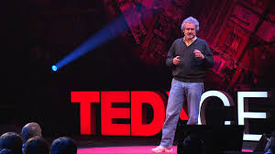
An “argument” with a world renowned personality
(Neil Gershenfeld)
Only few people have got ability to assemble circuits which requires precision. Only those guys need to learn from Fablab.
What If someone wants to learn stuff for understanding it or to take executive decision on a stuff?
……
…….
…….
“ Why should you learn something which is not going to be used”?
“I would like to learn a stuff to reason about it!
Learn for Reasoning!

Slide 24
Some Conceptual Tools for Polyglot Programming

Slide 25
Let us Discuss these Three Things
What is the primary difference between Stored Procedure and a Stored Function in the case of RDBMS Software?
Have u Come across a Declarative Language in an Imperative Language and Vice Versa ?
Please name a Reference Type which obeys value semantics in Java and C#?

Slide 26
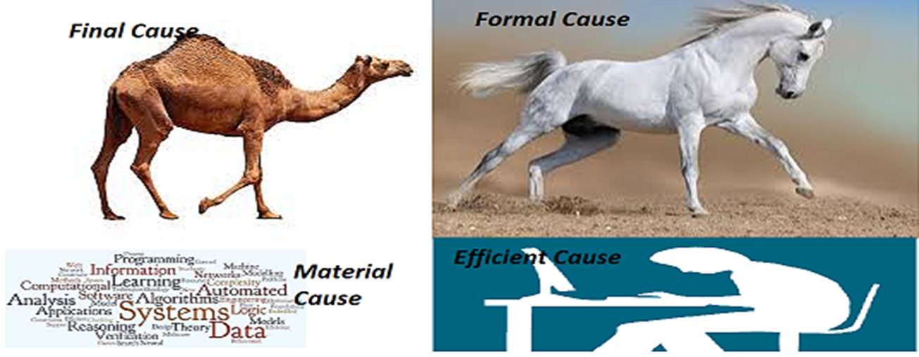
A Camel is a horse designed by a committee – Perils!

Slide 27
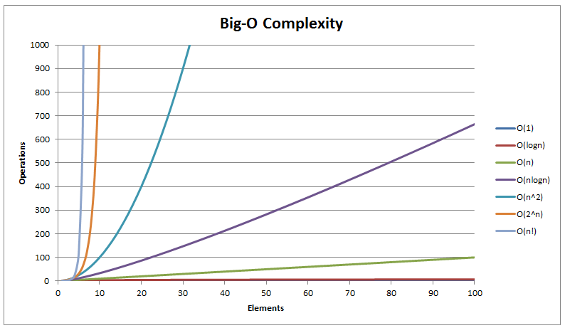
Algorithmic Complexity

Slide 28
Three Programs to demonstrate Intractability
Permuation
SubSet
Data set generation

Slide 29
Algorithmic Landscape
After you have tried If/else/while/select/update programming Linear/Quadratic complexity algorithms Patented algorithms Heuristics based solutions Approximate Solutions Stochastic solutions All of the above are control path programming. When these fail you can opt for Machine learning based solutions which will reason based on data.

Slide 30
Linear Algebra through Programming

Slide 31
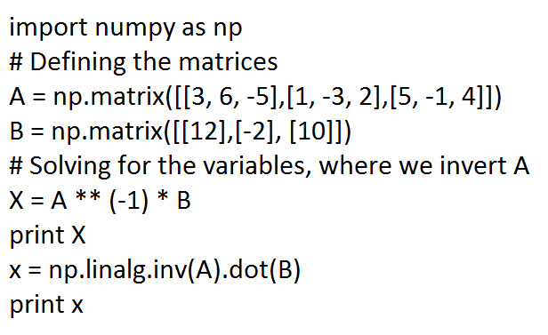
Learn Matrix Algebra through Python

Slide 32
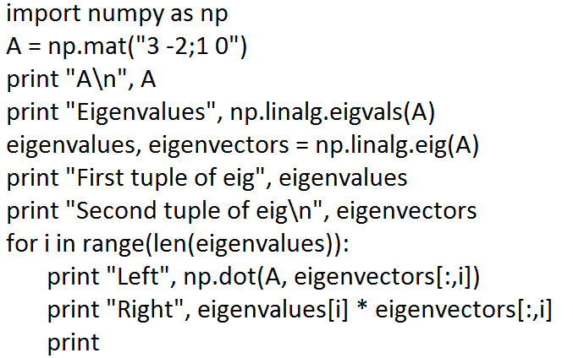
Eigen Value – Python Code

Slide 33
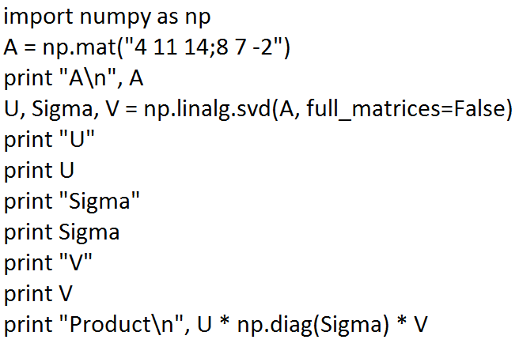
SVD

Slide 34
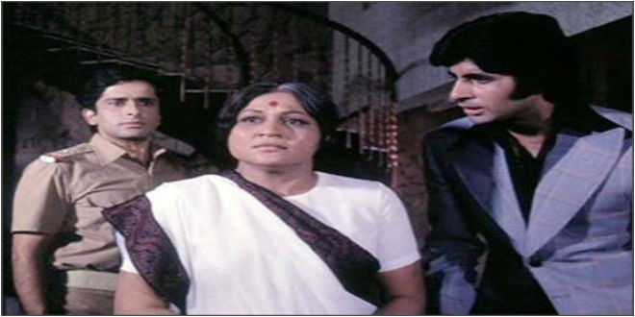
Which Language is important?
Aaj mere paas building(C++) hai, property(C#) hai ,bank balance (Java) hai, bungla(Python) hai,gaadi hai(PHP) Kya hai, Kya hai tumhare paas?....Mere Paas Maa (JavaScript) hai

Slide 35
Going Native! & Interfacing with it!

Slide 36
Native Code Programming
Compile/Link/Load cycle under Windows and POSIX
Static Linking of libraries
How to Create DLLs and Shared Objects (.so) in Windows and GNU Linux ?
32 bit vs 64 bit DLLs
Three Ways to invoke DLLs/Sos in Windows and GNU Linux
Linking with import library ( Loaded at the Load time of the executable)
On the fly loading of the DLL

Slide 37
Mixed Language Programming
How to invoke native code libraries?
Invoking native libraries written in C/C++ from C#
Invoking native libraries written in C/C++ from Java
Invoking native libraries written in C/C++ from Python
Importance of Mixed Language Programming
Jython and Jruby – Two case studies

Slide 38
Programming Paradigms and their origins

Slide 39
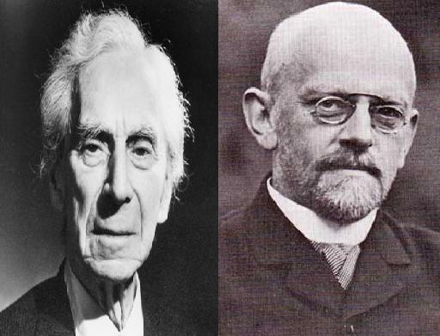
Who are they?

Slide 40
A Tale of two mathematicians
Bertrand Russell and David Hilbert spear headed a plan to reduce entire mathematics to Logic.
Hilbert’s 23 problems
Bertrand Russell and Alfred north Whitehead’s Principia Mathematica.
Barber Paradox – The Quagmire

Slide 41
Entscheidungsproblem (Decision Problem)
The problem of algorithmically determining whether a First Order Logic statement is universally valid
First Order Logic – Propositional Calculus + Predicate Calculus

Slide 42
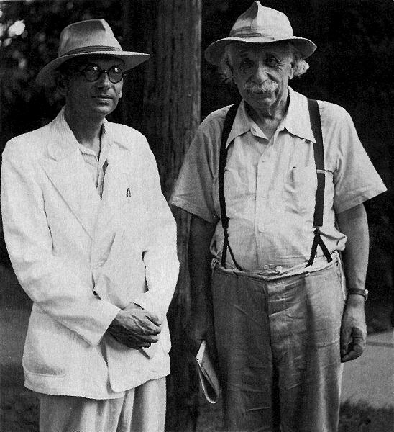
Who are they ?

Slide 43
KURT GODEL
Austrian Logician who proved the incompleteness theorem
Mathematics is not consistent ?
Demoralizing for the whole world
Return of the “GOD” ?

Slide 44
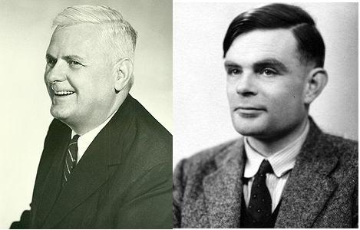
Hilbert's Scheme got broken

Slide 45
The BY-PRODUCT
Alonzo Church invented Lambda Calculus
Turing came up with the concept of Turing Machine
They were trying to solve the decision problem in the Predicate Calculus
Both Failed in finding an algorithmic procedure for the decision problem.
( Some stuff is not computable ! )‏

Slide 46
Three Programming Paradigms
Imperative Programming using C/C++,Java,C#,Perl and Visual Basic etc.
Turing Machine is the foundation.
Functional Programming using LISP,Scheme,ML,Haskell,Miranda etc.
Lambda Calculus is the foundation
Logic Programming using Prolog,DataLog, SQL etc
Based on Predicate Calculus

Slide 47
Imperative Programming
Command Oriented Programming.
Statement Oriented
Function is what u evaluate for it’s value and statement is what u execute for it’s effect.
X= X + 1 can give shiver to any person when he encounters it for the first time.

Slide 48
Functional Programming
Function as the unit of computation.
Functions can be composed arbitrarily
How can I write programs without Loop ?
Recursion is a good substitute.
Referential Transparency of the functions
Controlled manipulation of state is necessary for the real world.

Slide 49
Logic Programming
Declarative Model of computation
Logical Deduction is a medium for computation.
Has got good support for parallelism.
Heavy use of recursion and Depth first search.
Used in writing Huerisitics based programs.

Slide 50
Mathematics – The Secret behind successful Polyglot programming

Slide 51
Role of Mathematics
Sets vs Bags
Symmetric Set Difference for Data Synchronization
Relational Algebra and SQL
Regular Expression and Regular Grammar
Functions, Free/Bound variable/Capture,Closure

Slide 52
Types in Algebra
When we say We add x + y,
x:int + y:int => z:int (overflow!)
X can take value from a finite set (or a small subset of the possible values ) like PVS = { 0,1,2,3 } and Y can take value from another finite set { 1,2 }
When a value is attached to X or Y, we call it “Binding” ( There is no concept of Assignment in Mathematics! )

Slide 53
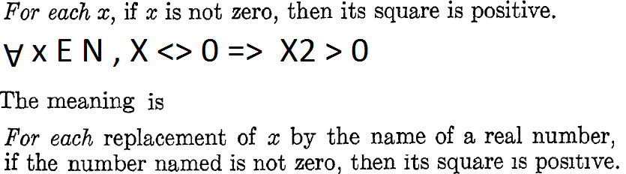
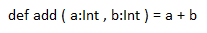
Universal Quantifier and Bounded Variable

Slide 54
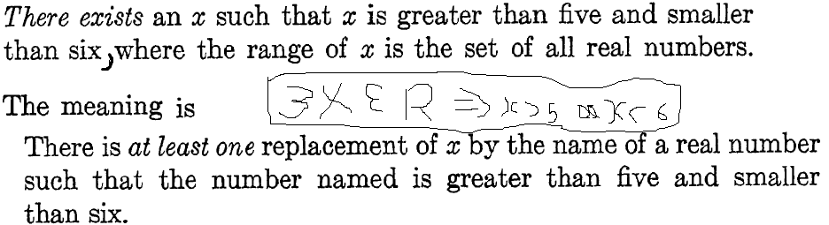
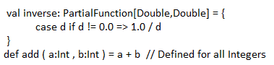
Existential Quantifier and Bound Variable

Slide 55
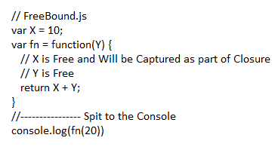
Free Variables

Slide 56
Associativity
( (A op B ) op C ) == (A op ( B op C ))
2 + 3 + 4 can be written as
( (2 + 3 ) + 4 ) or (2 + ( 3 + 4 ))
If a operator is associative, we can do parallel reduction ( a long sequence of numbers can be chunked into small sequence to be reduced by different people, processors or mechanical devices )

Slide 57
Commutativity
(A op B ) == (B op A )
2 * 3 can be written as 3 * 2
If a operator is commutative, order in which one performs operation does not matter
We can do Out of Order Execution ( Relational DB Engine exploits this property to evaluate relational cross products )
On top of Parallel reduction, we can perform Parallel shuffle as well )

Slide 58
Closure
When two Homogeneous Types of numbers are Operated Upon, if we get the same Type as result, it is called “Closure”
Addition of Two natural numbers are closed
So do Multiplication of Two Natural Numbers
Closure helps us to Chain Operations without much “trouble”

Slide 59
Algebra to Modern Algebra
Why Limit Algebra to Number Types?
Algebra of Sets ( Operations on Sets )
Algebra of Relations
Algebra of Matrices
Algebra of Vectors
Algebra on Groups, Rings, Fields, Lattices
We Create Hierarchy of Mathematical Structures with Varying Property
Mathematical Properties like Associativity, Commutativity, Closure nicely extrapolates to Modern Algebra

Slide 60
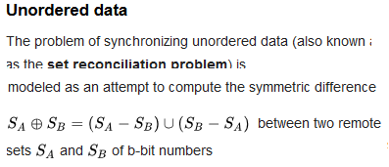
Sets and Computer Programming
Sets, Operations on Sets, Collections etc
MultiSet or Bag (Set with duplicates )
Symmetric Set Differences and Data Synchronization

Slide 61
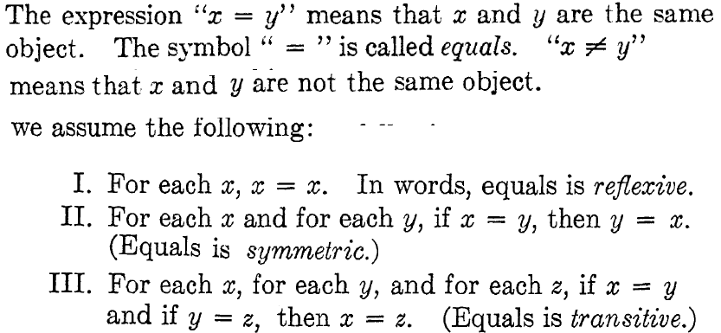
Some notions about Equality

Slide 62
Relations
Relations are subsets of Cartesian Products between Sets/Bags
We Apply a Predicate to find the Subset of Cartesian Product between two sets
Mathematical Properties of Relations like Reflexivity/Symmetry/Transitivity
Notion of Equality
Algebra of Relations ( which makes SQL engines tick )
Using Properties of Relation to Verify a COM Component.

Slide 63
Functions
Functions are mapping between Sets
There are injective/surjective/bijective mapping
Some mappings are Isomorphic ( with well defined inverses )
The notion of “Pure Function”
Anonymous Function (Lambda)
Composition of Functions
Capture of Variables (Closure)
Currying,Partial Application

Slide 64
Functions
Functions are mapping between Sets
There are injective/surjective/bijective mapping
Some mappings are Isomorphic ( with well defined inverses )
The notion of “Pure Function”
Anonymous Function (Lambda)
Composition of Functions
Capture of Variables (Closure)
Currying,Partial Application

Slide 65
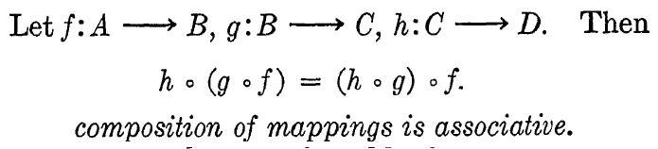
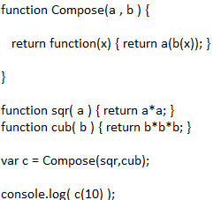
Functions are Compossible

Slide 66
Closure in FP
Correct Functional Composition works because of the Closure of Operations
A = F(G(H(X))) ( F map G map H on X )
The Closure of Operations are violated when we have non determinism , exceptions, nulls , I/O , Stateful operations
We will encapsulate the above “mess” into to implementation and try to give hygenic behavior at the interface level ( S*** will be in the Pit!)

Slide 67
Closure in SQL
Data is stored in a data structure called RelationlRelations can be combined using Rel Ops
CartesianProduct(Rel1,Rel2..Reln) => Rel
Restrict(Rel,Predicate) => Rel
Project(Rel,fieldlist) => Rel
Rename(Rel)=> Rel
SetOperators(Rel1..Reln) => Rel
Group(Rel,Pred) => Rel
And so on…

Slide 68
Closure in Regular Expressions
Re( NULL) => NULL
Re(“”) => “”
Re([a-z]) => [a-z]
Re.Re => Re
(Re | Re ) => Re
Re* => Re
The above stuff defines Re ( Recursive definition)
What about R+?
Re+ = Re.Re*

Slide 69
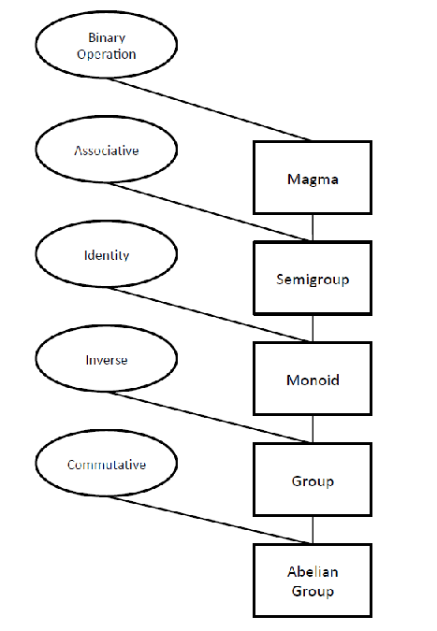
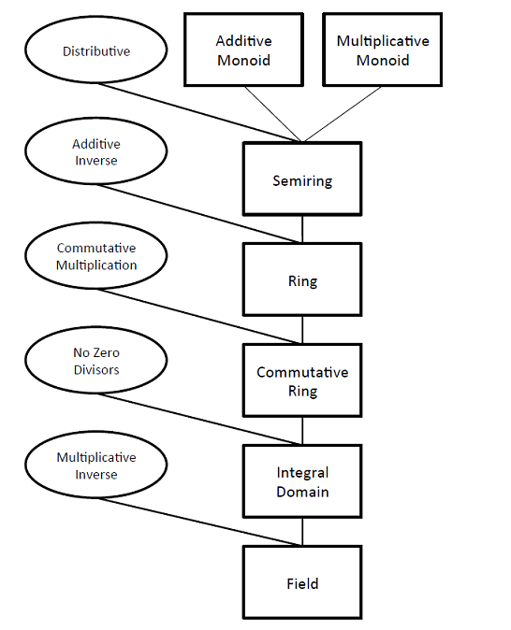
Algebra of Structures

Slide 70
Conclusion
Competence = Skill + Knowledge + Meta-Knowledge
Learn Programming Language Theory
Learn for Reasoning!
There are only three types of Programming paradigms
If you learn, those paradigms, every programming language is just a syntactic sugar
Be language agnostic and platform agnostic

Slide 71
Questions? If any!

